Slide 1

LGBoost Regression Algorithm

Slide 2
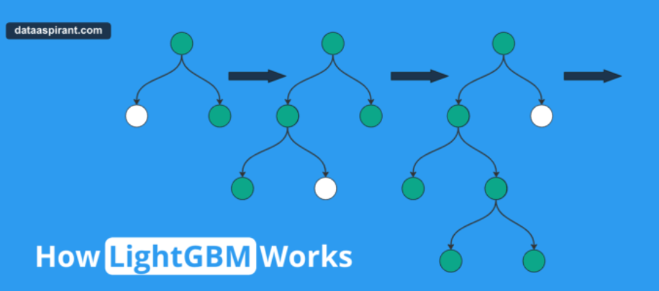
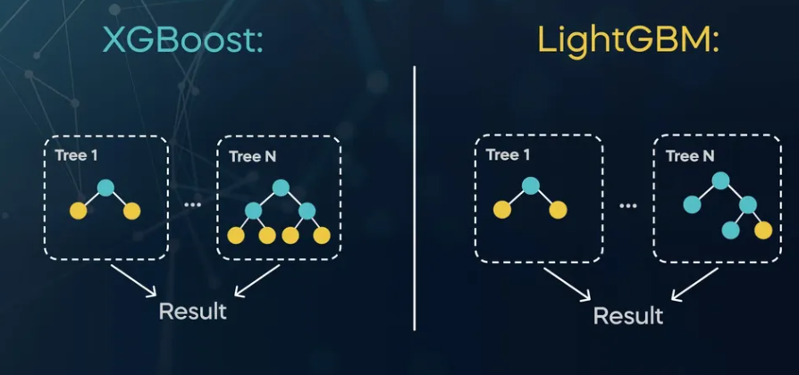
Introduction to LightGBM:
LightGBM: A Powerful Gradient Boosting Algorithm. It is a gradient boosting framework that uses tree-based learning algorithms.
Purpose: Designed for efficiency and performance in machine learning tasks.
Why Use LightGBM for Regression?
High performance: Faster training speed and higher efficiency.
Scalability: Handles large datasets with lower memory usage.
Accuracy: Often achieves better results than other boosting algorithms

Slide 3
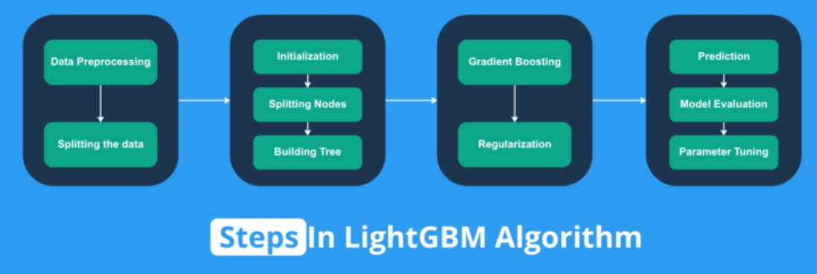
Key Features of LightGBM
Histogram-based learning: Groups continuous values into discrete bins.
Leaf-wise growth: Grows trees leaf-wise for reduced loss.
Support for categorical features: Directly handles categorical variables.
Step-by-step process:
Data preprocessing and binning.
Training using gradient boosting.
Building trees based on gradients.
Updating predictions iteratively

Slide 4
Advantages of LightGBM
Speed and efficiency: Faster training times with parallel and distributed computing.
Memory usage: Lower memory consumption.
Flexibility: Supports various objective functions and metrics.
Slide 8: Hyperparameters Tuning
Key hyperparameters:
Learning rate
Number of leaves
Maximum depth
Subsampling rates
Importance: Fine-tuning these parameters can significantly affect performance
LightGBM is a powerful, efficient algorithm for regression tasks with strong performance in large datasets.

Slide 5


